Slide 1
Finishing this project
http://cwbuecheler.com/web/tutorials/2014/restful-web-app-node-express-mongodb/
We will add some more users by doing some AJAX posting.
PART 7 - ADDING USERS

Slide 2
In the next PPT
We will add some more users by doing some AJAX posting.

Slide 3
Add a set of form fields
For user to add a new user in /views/index.jade
Right below our user list, but above the closing wrapper comment, add 4 inputs and a button

Slide 4
// ADD USER
h2 Add User
#addUser
fieldset
input#inputUserName(type='text', placeholder='Username')
input#inputUserEmail(type='text', placeholder='Email')
br
input#inputUserFullname(type='text', placeholder='Full Name')
input#inputUserAge(type='text', placeholder='Age')
br
input#inputUserLocation(type='text', placeholder='Location')
input#inputUserGender(type='text', placeholder='gender')
br
button#btnAddUser Add User
// /ADD USER

Slide 5
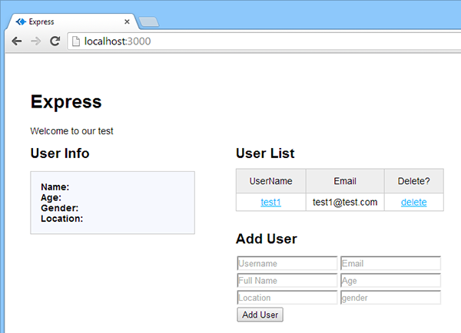
If you run it now
Jade is very touchy about tabs/spaces.
If you're getting errors, check all of your indents and try restarting

Slide 6
Now in /routes/users.js we will POST new data from client to server
Below your user listing code, but above module.exports, add the following code:
/* * POST to adduser. */
router.post('/adduser', function(req, res) {
var db = req.db;
var collection = db.get('userlist');
collection.insert(req.body, function(err, result){
res.send(
(err === null) ? { msg: '' } : { msg: err }
);
});
});
This says “we're going to post some data (req.body), and you're going to insert it into our
‘userlist' collection in the database. If that goes well, return an empty string. If not, return
the error message that the database gives us.”

Slide 7
Need to make that new form/button do something. Edit global.js
First write our event catcher, in the DOM Ready section, just below the user list name click
// Add User button click $('#btnAddUser').on('click', addUser);
As we're calling an addUser function, we'll need to code that function. This is going to be a large chunk of code because it has to do some rudimentary form validation and then, if the form's all filled out, compile the data and POST it via AJAX to our adduser service.
Add next page at the bottom of global.js

Slide 8
// Add User
function addUser(event) {
event.preventDefault();
// Super basic validation - increase errorCount variable if any fields are blank
var errorCount = 0;
$('#addUser input').each(function(index, val) {
if($(this).val() === '') {errorCount++; }
});
// Check and make sure errorCount's still at zero
if(errorCount === 0) {
// If it is, compile all user info into one object
var newUser = {
'username': $('#addUser fieldset input#inputUserName').val(),
'email': $('#addUser fieldset input#inputUserEmail').val(),
'fullname': $('#addUser fieldset input#inputUserFullname').val(),
'age': $('#addUser fieldset input#inputUserAge').val(),
'location': $('#addUser fieldset input#inputUserLocation').val(),
'gender': $('#addUser fieldset input#inputUserGender').val()
}

Slide 9
// Use AJAX to post the object to our adduser service
$.ajax({
type: 'POST',
data: newUser,
url: '/users/adduser',
dataType: 'JSON'
}).done(function( response ) {
// Check for successful (blank) response
if (response.msg === '') {
// Clear the form inputs
$('#addUser fieldset input').val('');
// Update the table
populateTable();
}
else {
// If something goes wrong,
// alert the error message that our service returned
alert('Error: ' + response.msg);
}
});
}
else {
// If errorCount is more than 0, error out
alert('Please fill in all fields');
return false;
}
};

Slide 10
// Add User
function addUser(event) {
event.preventDefault();
// Super basic validation - increase errorCount variable if any fields are blank
var errorCount = 0;
$('#addUser input').each(function(index, val) {
if($(this).val() === '') {errorCount++; }
});
// Check and make sure errorCount's still at zero
if(errorCount === 0) {
// If it is, compile all user info into one object
var newUser = {
'username': $('#addUser fieldset input#inputUserName').val(),
'email': $('#addUser fieldset input#inputUserEmail').val(),
'fullname': $('#addUser fieldset input#inputUserFullname').val(),
'age': $('#addUser fieldset input#inputUserAge').val(),
'location': $('#addUser fieldset input#inputUserLocation').val(),
'gender': $('#addUser fieldset input#inputUserGender').val()
}
// Use AJAX to post the object to our adduser service
$.ajax({
type: 'POST',
data: newUser,
url: '/users/adduser',
dataType: 'JSON'
}).done(function( response ) {
// Check for successful (blank) respon
if (response.msg === '') {
// Clear the form inputs
$('#addUser fieldset input').val('');
// Update the table
populateTable();
}
else {
// If something goes wrong,
// alert the error message that our service returned
alert('Error: ' + response.msg);
}
});
}
else {
// If errorCount is more than 0, error out
alert('Please fill in all fields');
return false;
}
};

Slide 11
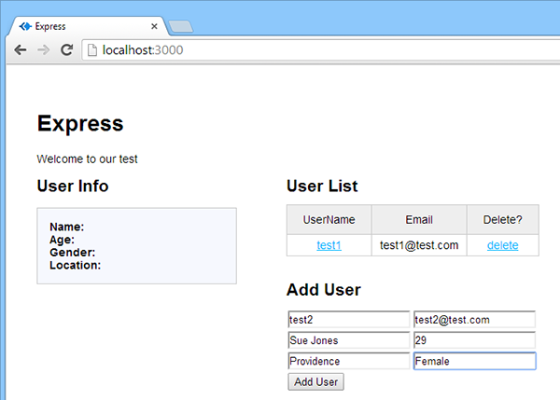
Now are form should add names

Slide 12
Click add, and the form should submit
the data should be sent off to the database, and the table should refresh to show this fact.
Click on your new username in that table, and you'll get your new user info in the info box.
Note that all of this happened without any kind of a page refresh, which is what we get using the Asynchronous JAvaScript and XML. (now more often json)
With AJAX you can:
Update a web page without reloading the page
Request data from a server - after the page has loaded
Receive data from a server - after the page has loaded
Send data to a server - in the background

Slide 13
Lastly – Deleting users
This is easier than adding users, but it's largely the same process:
update our route file and update global.js
we don't have to touch index.jade because we already put our delete links in that code
Open /routes/users.js and add the following to the bottom, just above module.exports:

Slide 14
/* * DELETE to deleteuser. */
router.delete('/deleteuser/:id', function(req, res) {
var db = req.db;
var collection = db.get('userlist');
var userToDelete = req.params.id;
collection.remove({ '_id' : userToDelete },function(err) {
res.send((err === null) ? { msg: '' } : { msg:'error: ' + err });
});
});
We pass in an ID parameter so the URI we'll be referencing will be
/deleteuser/12345 for example,
and we reference it in the code with req.params.id
And MongoDB matches it up with the unique _id field that it generates for every
entry in a collection, and deletes it.
Just like our add user routine, if all goes well it returns a blank string,
and if things don't work out it sends back the error message from MongoDB.

Slide 15
Now we will connect these in global.js
We've already populated each delete link with a rel attribute that contains the id. It's in this line from global.js:
tableContent += '<td><a href="#" class="linkdeleteuser" rel="' + this._id + '">delete</a></td>';

Slide 16
Now add a delete routine in our DOM Ready section
// Delete User link click
$('#userList table tbody').on('click', 'td a.linkdeleteuser', deleteUser);
Note the syntax we're using: when working with jQuery's ‘on' method,
in order to capture dynamically inserted links, you need to reference a
static element on the page first. That's why our selector is the table's
tbody element – which remains constant regardless of adding or
removing users – and then we're specifying the specific links we're
trying to catch in the .on parameters.
Now add a new deleteUser function down at the bottom of this file

Slide 17
// Delete User
function deleteUser(event) {
event.preventDefault();
// Pop up a confirmation dialog
var confirmation = confirm('Are you sure you want to delete this user?');
// Check and make sure the user confirmed
if (confirmation === true) {
// If they did, do our delete
$.ajax({
type: 'DELETE',
url: '/users/deleteuser/' + $(this).attr('rel')
}).done(function( response ) {
// Check for a successful (blank) response
if (response.msg === '') {
}
else {
alert('Error: ' + response.msg);
}
// Update the table
populateTable();
});
}
else {
// If they said no to the confirm, do nothing
return false;
}
};

Slide 18
How about updating an existing user?
Hopefully you have a solid idea of how to do that.
First you'd GET the info and populate a form with it,
then you'd PUT on submission of the form (see the beginning of this tutorial for info on POST vs. PUT), and update the table.
Just like for adding and deleting. You'll need to edit
/views/index.jade
/routes/users.js
/app.js
/public/javascripts/global.js

Slide 19
This is a rudimentary RESTful web app.
It gives no thought to performance or to “what happens when my table has 1,000 users instead of 10?”-type questions.
It also doesn't worry a lot about flexibility, maintainability, or future additions.
The purpose was merely to get you up to speed with single-page, ajax-driven data manipulation in Node / Express / MongoDB.
For more on REST and the best ways to approach it, he recommends the following articles:
Best Practices for Designing a Pragmatic RESTful API by Vinay Sahni
Suggested REST API Practices (2013) by Matthew Beale

